Slide 1
Manager Workspaces and users
Manager Workspaces and users

Slide 2

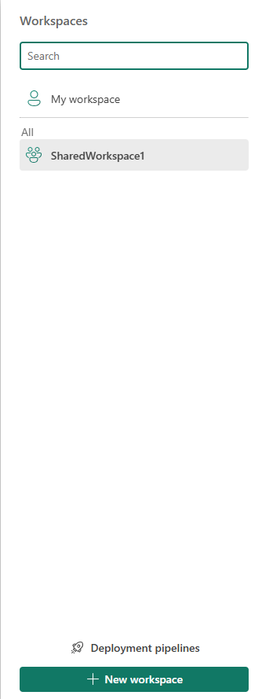
Deploy report
Note: This lab needs a Power Services Account
Create a shared workspace by selecting Workspaces and then clicking New workspace button
Name the shared workspace SharedWorkspace1

Slide 3
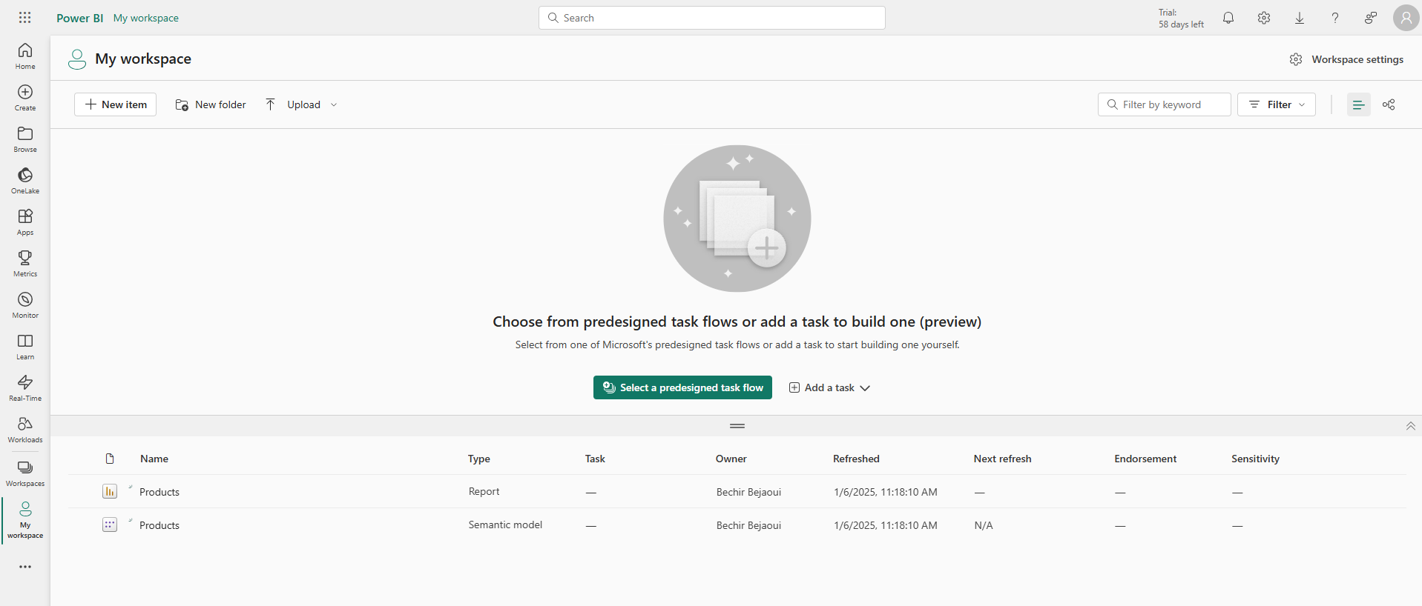
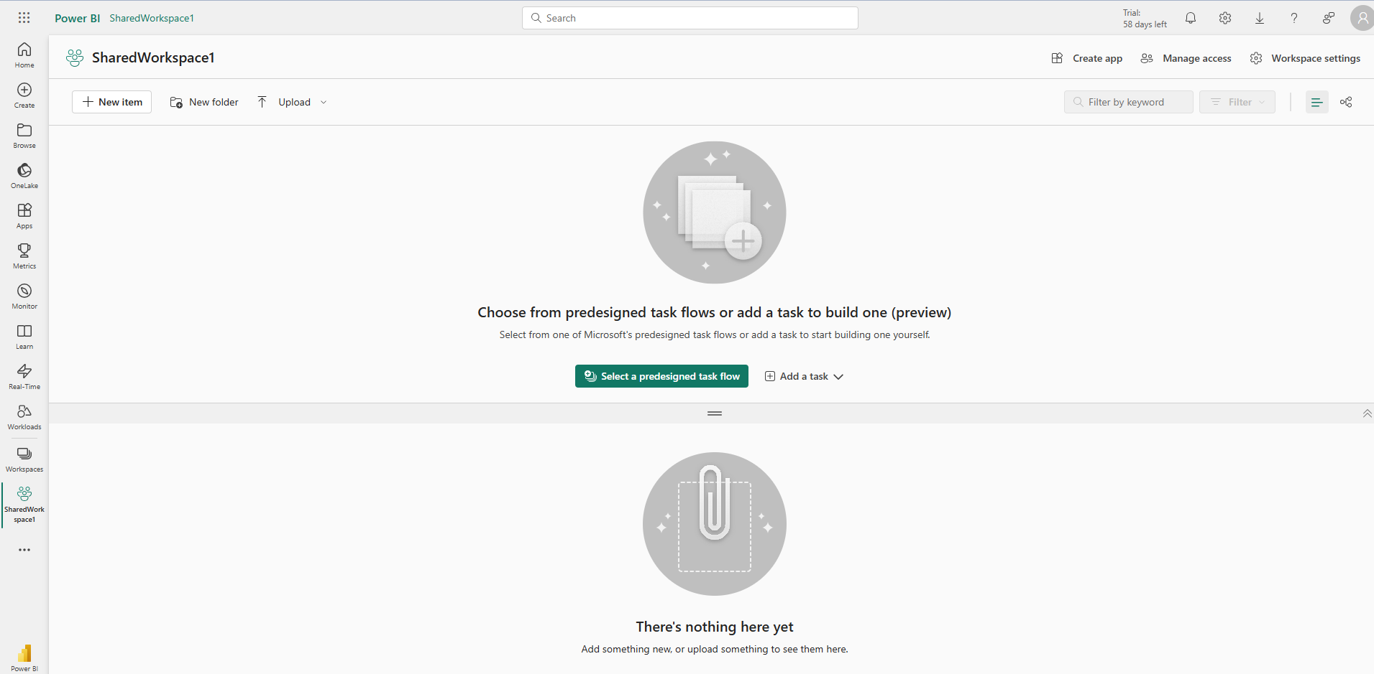
Deploy report
Compare the My Workspace to the Sharedworkspace1

Slide 4
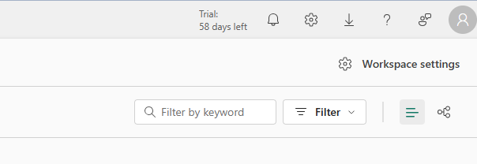
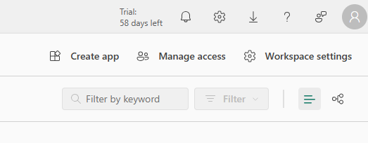
Deploy report
Note the difference between the both workspaces right side menu
My workspace
1
2
Shared workspace

Slide 5
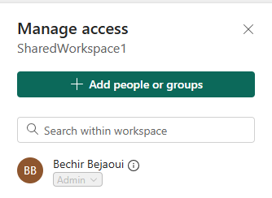
Deploy report
Click Manage Access and note that we can add users or groups, note also the presence of the admin
Shared workspace

Slide 6
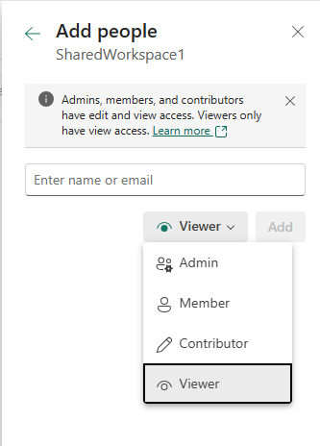
Deploy report
It is possible to invite user to collaborate within the shared workspace, and define a relative profile to that user
Admin: Full control.
Member: Can edit reports/datasets.
Contributor: Can publish reports but not edit others'.
Viewer: Can only view content.
1
Invite by email
2
Define the profile

Slide 7
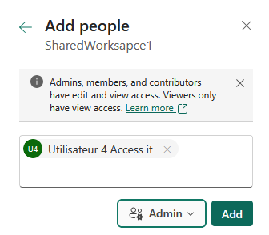
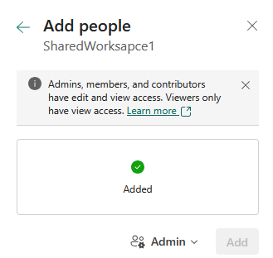
Deploy report
We can check user by name or by email

Slide 8
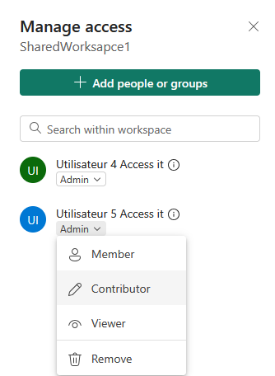
Deploy report
We can then manager users within the workspace by clicking the arrow button as follow

Slide 9
Thank you
Thank you

